Slide 1



Protein interactions and binding site properties
Allegra Via

Slide 2
Shared notes: http://bit.ly/bioinfoplanner2020

Slide 3
Chapter 1: Introduction to Protein-ligand interactions
Principles of protein interactions and binding site properties (lecture)
Forces at play in protein interactions (lecture)
Chapter 2: Protein-protein docking
General principles and challenges of docking (lecture)
Protein-protein docking with ClusPro (tutorial)
ClusPro results analysis (tutorial)
Chapter 3: Protein-protein interaction networks
Resources (databases) to study PPI (lecture)
Searching IntAct and STRING (tutorials)
Principles of graph theory and PPI networks (lecture)
Studying PPI with Cytoscape (tutorial)
Chapter 4: Protein-small molecule interactions
Drugs and drug targets (lecture)
The drug development process and drug design(lecture)
Databases and tools to study protein-small molecule interactions (tutorial)

Slide 4
Principles of protein interactions and binding site properties

Slide 5
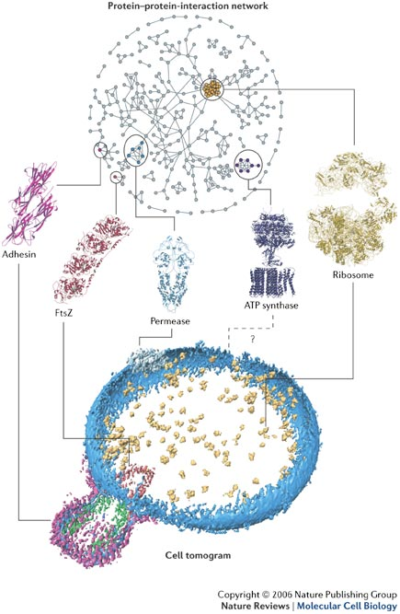
Reductionist biology – molecular viewpoint
Specific molecule(s) of interest
Experiments to determine interaction partners and modes of interaction
Prediction of interaction partners and modes of interaction
Analysis of specific interaction

Slide 6
Protein networks
Identification of functional modules (set of proteins highly connected to each other)
Hubs, singletons
Networks' analysis -> biological hypotheses
Prediction of new interactions
Reductionist biology – molecular viewpoint
Specific molecule(s) of interest
Experiments to determine interaction partners and modes of interaction
Prediction of interaction partners and modes of interaction
Analysis of specific interaction

Slide 7
Protein networks
Identification of functional modules (set of proteins highly connected to each other)
Hubs, singletons
Networks' analysis -> biological hypotheses
Prediction of new interactions
Reductionist biology – molecular viewpoint
Specific molecule(s) of interest
Experiments to determine interaction partners and modes of interaction
Prediction of interaction partners and modes of interaction
Analysis of specific interaction
Systems biology
Networks, pathways implicated in a condition
Identify perturbed or deregulated systems
Modelling of the system to infer to signals and/or deregulation events
Experiments to determine responses of the system

Slide 8
Protein-ligand interactions
Protein functions are based on the capability of proteins to bind a certain ligand (or more)
elemental ions
small organic molecules (~600 Da or less)
peptides
macromolecules

Slide 9
A few definitions
Binary interaction
Protein complex
Homo vs hetero
Stable vs transient
Protein binding interface
Protein networks, hubs
Interactome

Slide 10
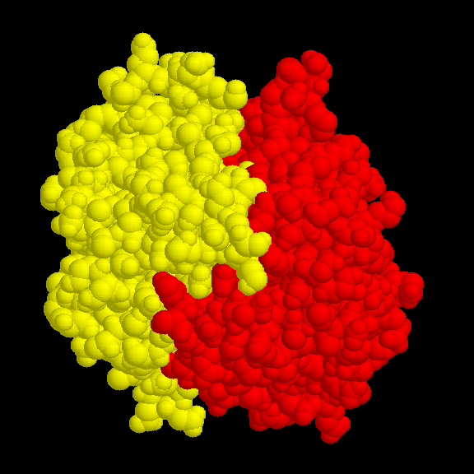
Binary interactions

Slide 11
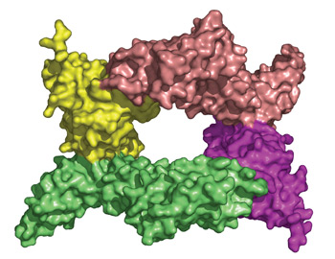
Protein complex
A structural image of the protein-protein complex formed when Yersinia pestis YpkA (green and pink) binds to the Rac1 protein of the host cell (yellow and purple)

Slide 12
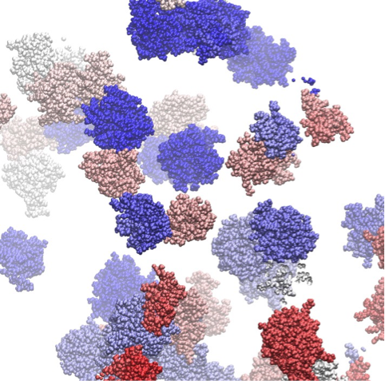
Protein interaction interfaces
Molecular dynamics simulation snapshot of a colicin E9 and Im9 protein solution (van der Waals presentation and individual colors for each protein) indicating multiple transient association events
Copyright: © Technische Universität München, Physik-Department T38
http://www.gauss-centre.eu/gauss-centre/EN/Projects/LifeSciences/2014/zacharias_crowded_enviroment.html?nn=1361034

Slide 13
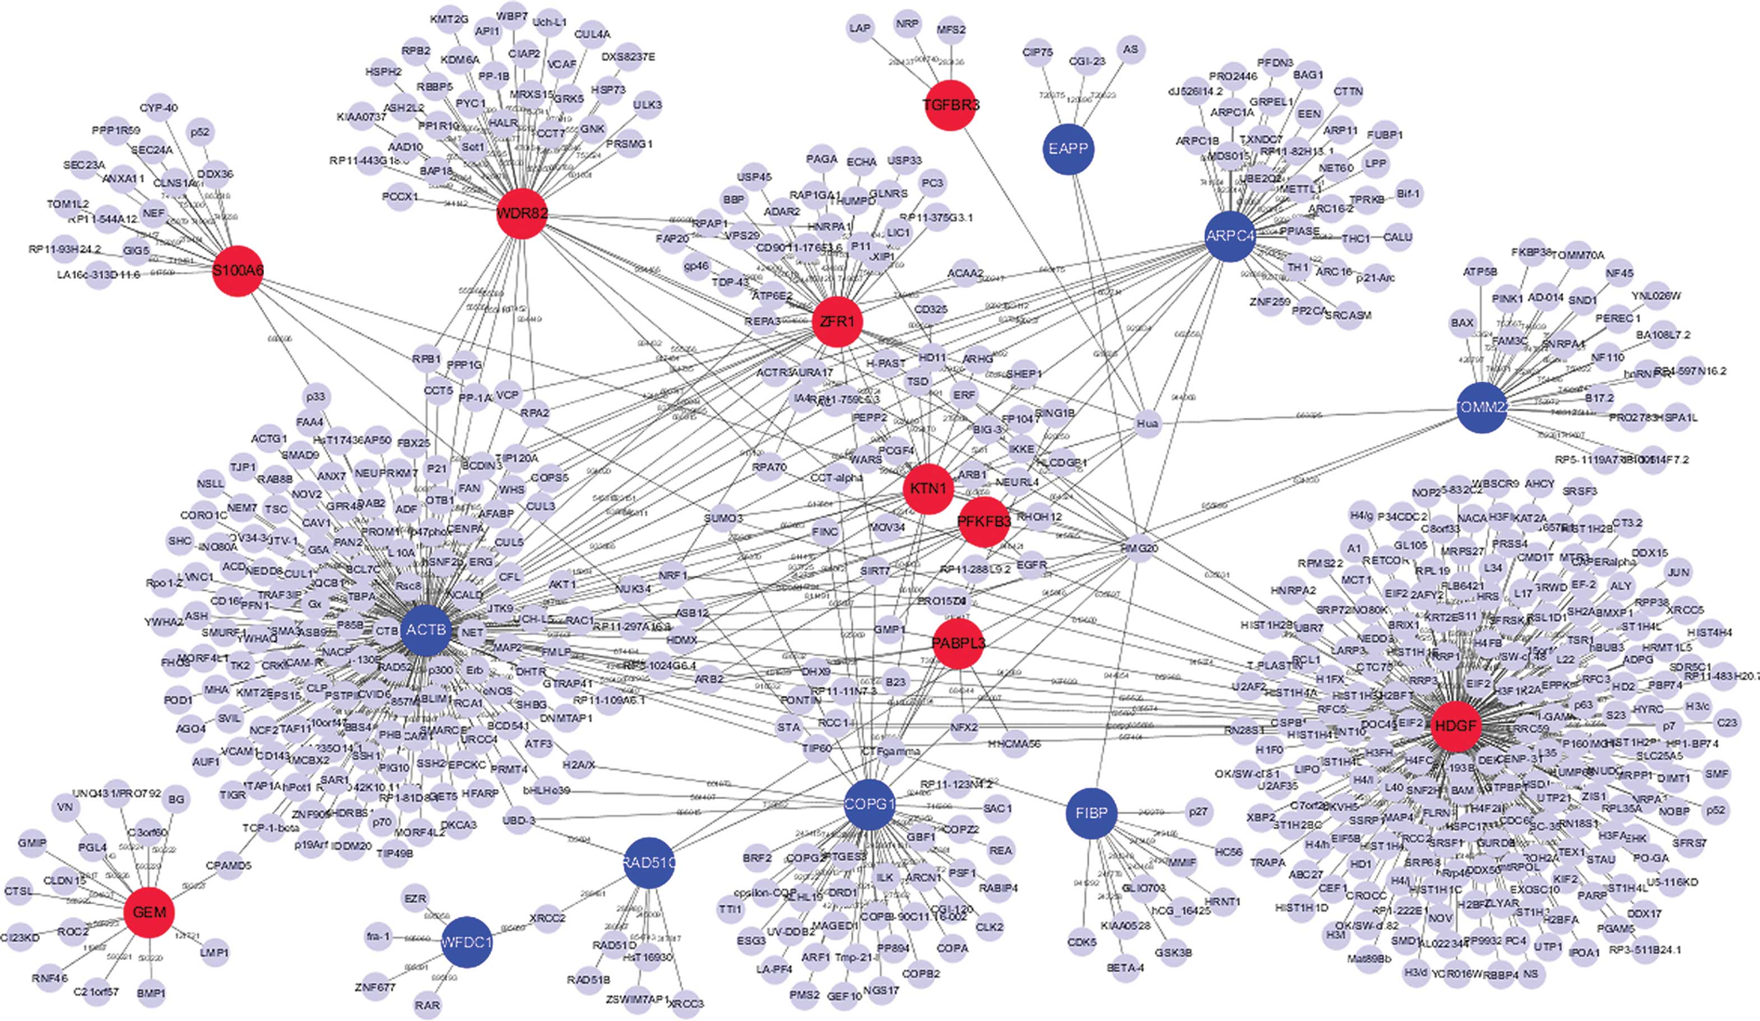
Protein interaction network: hubs, non-hubs

Slide 14
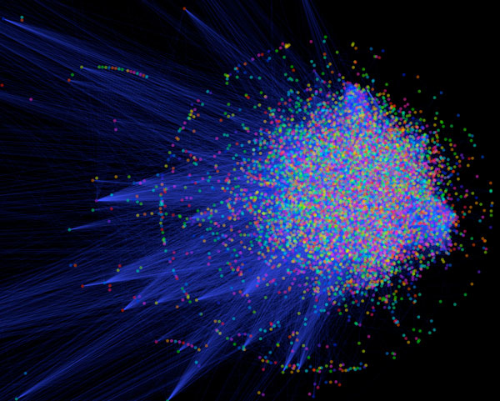
In an organism, PPIs form a huge complex network known as an “interactome”
Nearly 650,000 interactions regulate human life
Any deregulation leads to a disease state or death

Slide 15
PPIs are at the basis of key cellular processes
Signal transduction/communication
Enzyme-mediated catalysis
Immune response
Cellular division
Programmed cell death
Cell-cell recognition
Viral action
Metabolic and genetic regulatory networks

Slide 16
Roles of ligands
Catalysis: substrate, products, cofactors
Regulation: ATP, hormones, etc.
Communication pathways: first or second messengers, downstream regulators
Protein trafficking: ligands serving as means by which organelles or other macromolecules are recognised by proteins
Prosthetic groups: heme group
Defense/offense: toxins

Slide 17
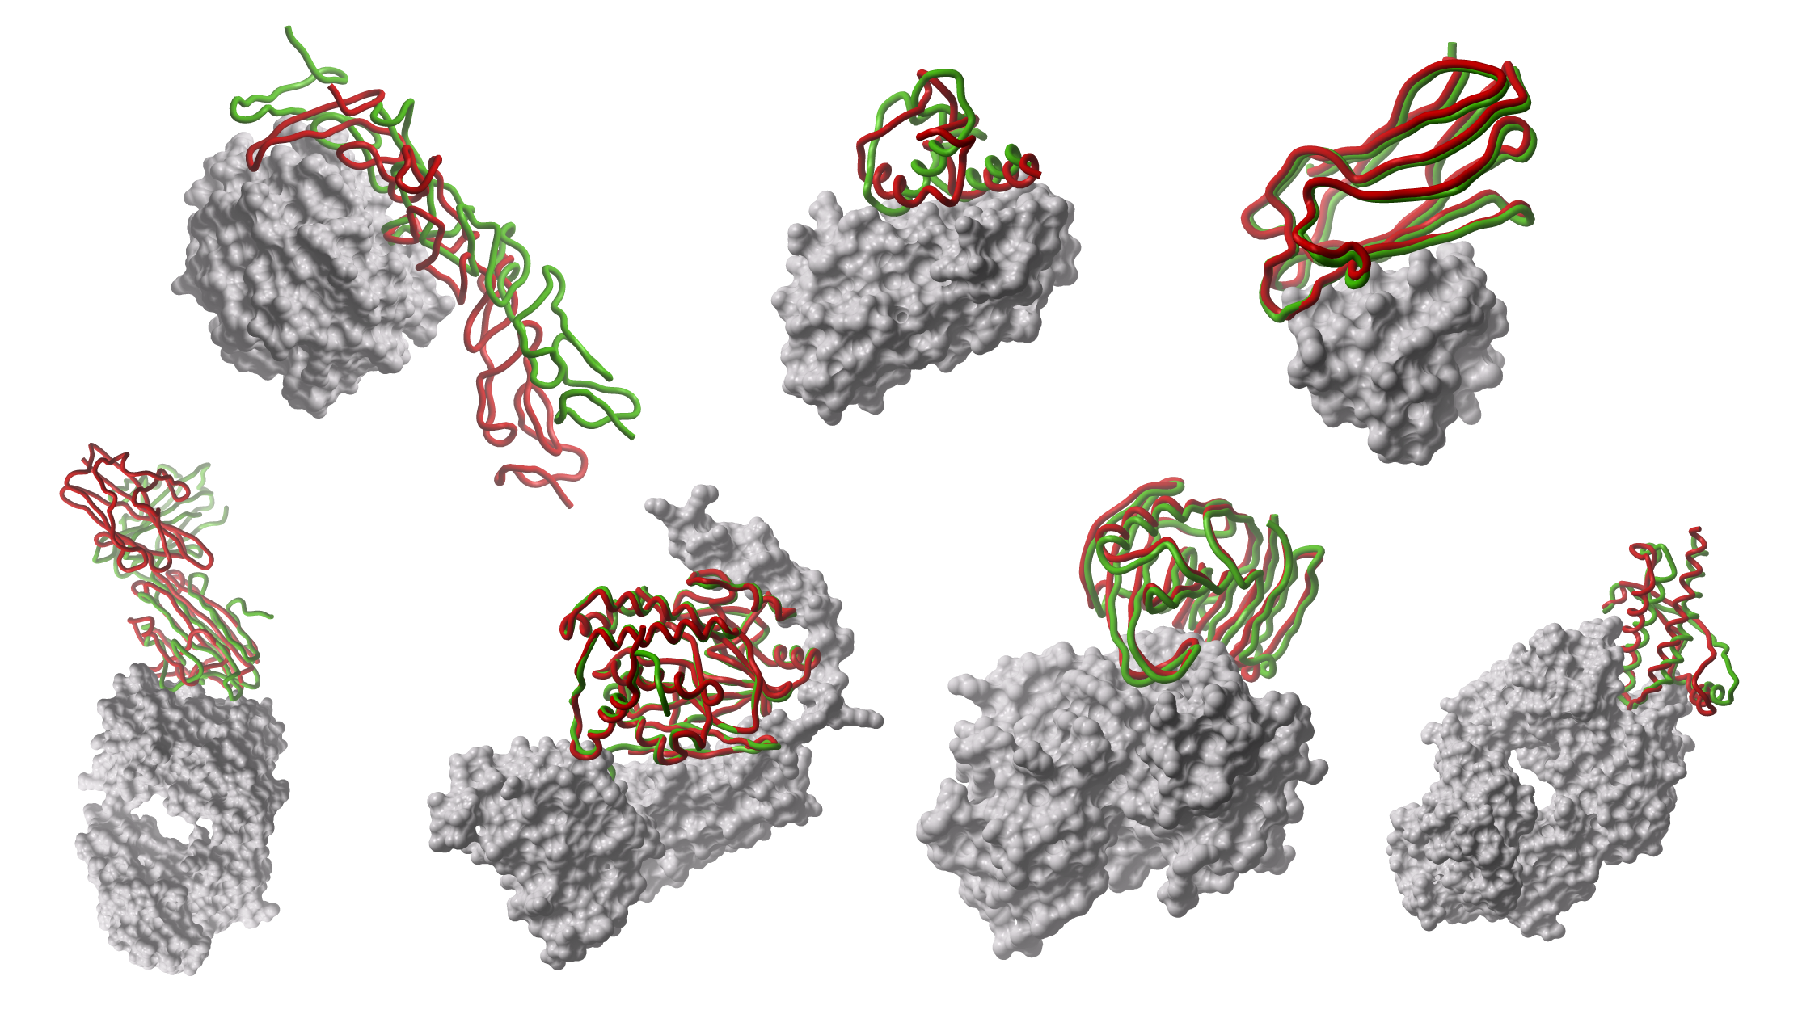
The reductionist approach

Slide 18
We can classify PPIs according to:
Biological context: enzyme-substrate, antibody-antigen, receptor-hormone/neurotransmitter
Permanence of binding: permanent-obligate vs transient
Similarity of the binding partners: homo vs hetero
Number of binding partners: hub, non-hub
Some of the above categories may partially overlap

Slide 19
Strong transient: This category includes interactions that are triggered/stabilised by an effector molecule or conformational change. An example is given by the Ras proteins, which form tight complexes with their partners when GTP-bound and only weak complexes when GDP-bound.
Perkins et al, Structure, 2010

Slide 20
Transient vs Stable
Transient (relatively weak)
Brief and reversible interactions occurring in specific cellular contexts
Stable (for a longer period of time)
Proteins take part of permanent complexes as subunits, in order to carry out structural or functional roles
Vocabulary: permanent, obligate, oligomeric, tight, more stable

Slide 21
Examples
Transient interactions
Interactions mediated by short linear motifs
Interactions mediated by PTMs
Disorder-to-order transitions
Proteins involved in signalling cascades
Stable interactions
Homo-oligomeric or hetero-oligomeric complexes
Interactions mediated by PTMs
enzyme-inhibitor
antibody-antigen
domain-domain
domain-peptide
Perkins et al, Structure, 2010

Slide 22
Protein-ligand interfaces Structure-function relationship
The ability of proteins to form biologically active complexes depends on the properties of their binding surfaces:
Size
Geometric compatibility
Chemical composition
Polarity
Atom packing efficiency
Hydrogen bond or salt bridge frequency
Number of buried water molecules
Interaction energy
Residue conservation
Types of secondary structures

Slide 23
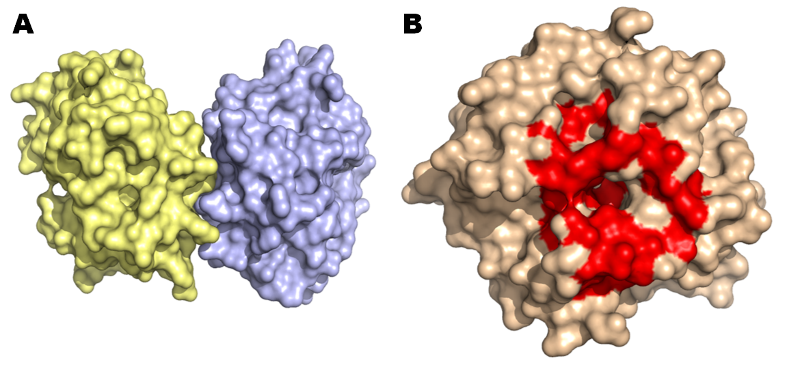
A. Hpx14 homodimer (PDB 3C7X) B. Definition of the docking site (red patch)

Slide 24
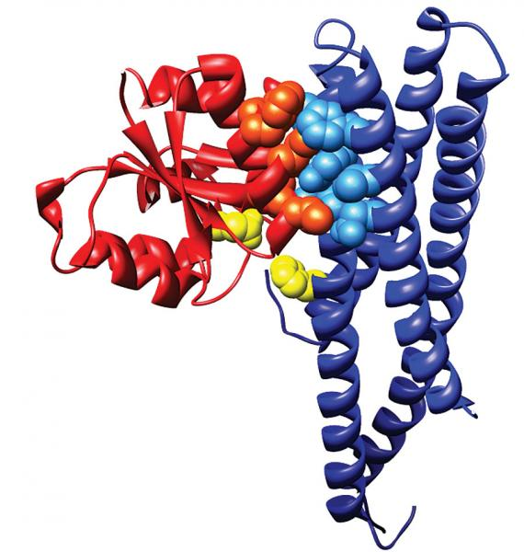
membrane-bound sensor histidine kinase
response regulator
. The catalytic residues that exchange a phosphoryl group are shown in yellow (courtesy of Alexander Schug and Hendrik Szurmant)

Slide 25
Check-point I
Go to the GDoc
Write your name
After your name, write a summary of the lecture, namely all you remember from the lecture.
You have access to the presentation, which means you can go through the slides to better remember and organise your text

